Slide 1

Web Development 1
© Hugh McCabe & Matt Smith 2008-2014
Lecture 2d
CSS styling colours and text

Slide 2
Steps for adding CSS to a web page
Start with a (valid!) HTML document
HTML structure markup (DOCTYPE, head, body)
HTML text markup (<p>, <h1-6>, <em>, <strong>, etc.)
Add the @import style statement for CSS text file
Choose an appropriate CSS file name (e.g. “goose.css”)
Create a folder /css
Add your CSS rules in the CSS text tile
Save CSS text file and check it worked
TEST & VALIDATE as you go
TIP: Work on 1 rule at a time, and 1 style property at a time …
(don’t type 100s of lines and then see if they work !)

Slide 3
1. Start with a (valid!) HTML document

Slide 4
Step 3: Identify Text Elements
<!DOCTYPE html>
<html lang="en">
<head>
<meta charset="utf-8">
<title> Black Goose Bistro </title>
</head>
<body>
<h1> Black Goose Bistro</h1>
<h2> The Restaurant</h2>
<p> The Black Goose Bistro offers casual lunch and dinner fare in a hip atmosphere</p>
<h2> Catering</h2>
<p> You have fun ... <em> we'll handle the cooking</em>. Black Goose Catering can handle events from snacks for bridge club to elegant corporate fundraisers.</p>
<h2> Location and Hours </h2>
<p> Seekonk, Massachusetts;
Monday though Thursday 11am to 9pm, Friday and Saturday, 11am to midnight </p>
</body>
</html>

Slide 5
2. Add @import style statement for CSS text file

Slide 6
In the HTML head tell browser to import style rules …
<!DOCTYPE html>
<html lang="en">
<head>
<meta charset="utf-8">
<title> Black Goose Bistro </title>
<style>
@import "css/goose.css";
</style>
</head>
<body>
Black Goose Bistro
The Restaurant
The Black Goose Bistro offers casual lunch and dinner fare Etc....

Slide 7
3.
Create a folder /css

Slide 8
4. Add your CSS rules in the CSS text tile

Slide 9
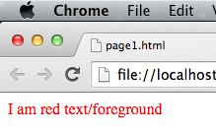
CSS properties and values
Foreground (text) COLOUR
Slide 9

Slide 10
Text/foreground colour / background colour
Property | Value(s)
color | [colour name]
 | [colour number]
Examples (colour names):
h1 { color: red; }
h1 { color: lightblue; }
h1 { color: black; }
h1 { color: pink; }
NOTE: US spelling ‘color’

Slide 11
Text/foreground colour / background colour
Property | Value(s)
color | [colour name]
 | [colour number]
Examples (colour numbers):
h1 {color: #666666; } /* hexadecimal */
h1 {color: rbg(255, 0, 128); } /* rgb (0..255) range */
h1 {color: rbg(100%, 0%, 50%); } /* rgb percentages */
h1 {color: hsl(120, 100%, 50%) } /* lime */

Slide 12
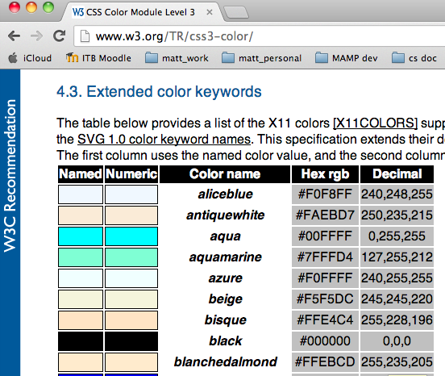
Reference sources for colour names
http://www.ironspider.ca/format_text/fontcolor.htm#colorchart
www.learningwebdesign.com/colornames.html
http://www.w3.org/TR/css3-color/#color0
http://www.w3.org/TR/css3-color/#svg-color
Now 140 predefined colour names in CSS 3 (the X11 standard)
Recognised in all up-to-date browsers

Slide 13
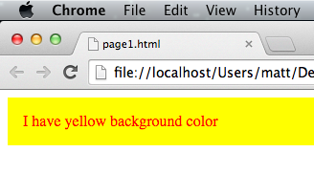
CSS properties and values
BACKGROUND colour

Slide 14
Text/foreground colour / background colour
Property | Value(s)
background-color | [colour name]
 | [colour number]
Examples:
body { background-color: lightblue; }
h1 { background-color: red; }
NOTE
US spelling ‘color’
CSS property names NEVER have spaces in them
Many have “-” hyphens, like “background-color”

Slide 15

A bit of CSS ... Changing colours for the Black Goose Bistro
/* ------ /css/goose.css ------ */
body {
background-color: lightblue;
}
h1 {
color: red;
}
It works ☺

Slide 16
CSS properties and values
Text ALIGNMENT (left / center etc.)

Slide 17
Aligning text
left center right justify
Property | Value(s)
text-align | left
 | right
 | center
 | justify
Examples
footer { text-align: right; }
h1 { text-align: center; }
NOTE: US spelling ‘center’

Slide 18
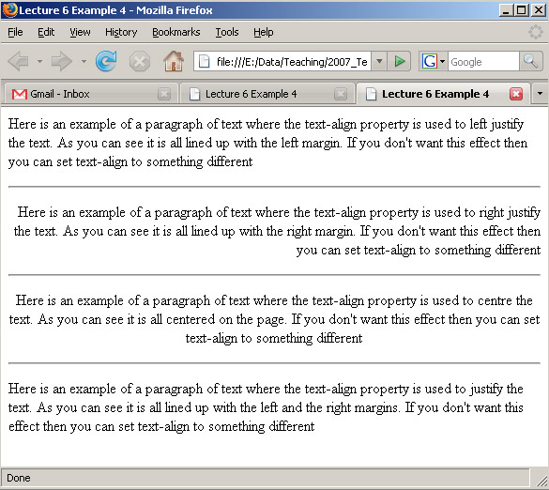
Text Line Adjustment – Alignment

Slide 19
CSS properties and values
More style properties …

Slide 20
Property | Value(s)
font-weight | normal
 | bold
footer { font-weight: bold; }
Property | Value(s)
font-style | normal
 | italic
 | oblique
h1 { font-style: italic; }
/* turn OFF italic for em & make pink */
em { font-style: normal;
color: pink; }
Property | Value(s)
text-decoration | none
 | underline
/* turn OFF underline for links on a page (& embolden) */
a { text-decoration: none;
font-weight: bold; }

Slide 21
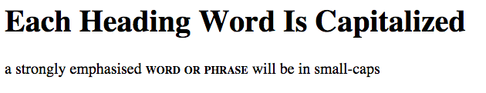
Property | Value(s)
font-variant | normal
 | small-caps
strong { font-variant: small-caps; }
Property | Value(s)
text-transformation | none
 | capitalize /* note US spelling ‘z’ */
 | uppercase /* ALL CAPITAL LETTERS */
 | lowercase /* all lowercase letters */
h1 { text-transform: capitalize; }
<h1>each heading word is capitalized</h1>
<p>a strongly emphasised <strong>word or phrase</strong> will be in small-caps</p>
HTML

Slide 22
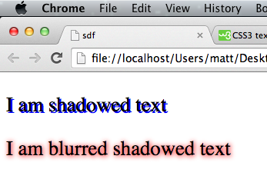
Property | Value(s)
text-shadow | h-shadow v-shadow none
 | h-shadow v-shadow color
 | h-shadow v-shadow blur color
p { text-shadow: 2px 2px blue; }
p { text-shadow: 1px 1px 8px red; } /* with blurring */

Slide 23
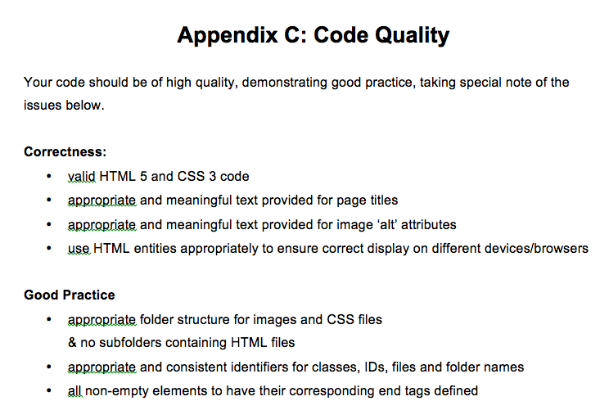
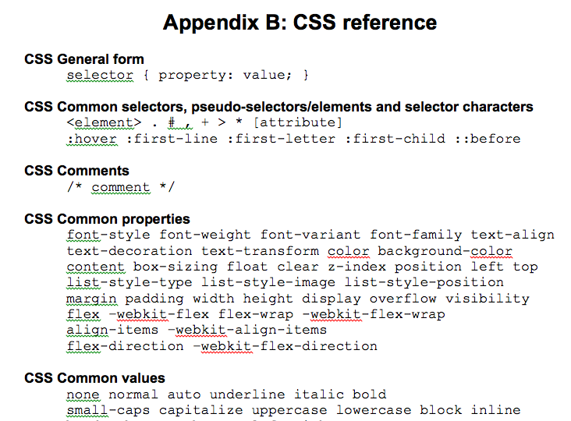
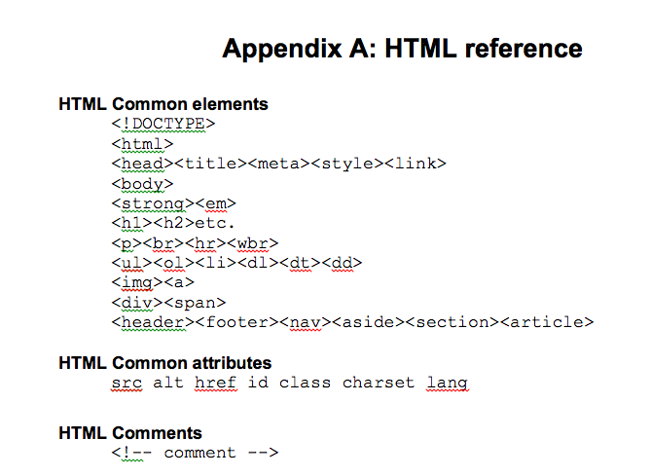
How am I meant to remember all these properties and values ?
You’re not expected to – see the standard exam appendices supplied:

Slide 24
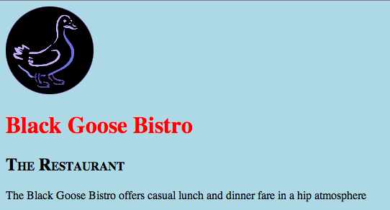
/* ------ /css/goose.css ------ */
body {
background-color: lightblue;
}
h1 {
color: red;
}
h2 {
font-variant: small-caps;
}
Above the ‘small-caps’ value for Level 2 headings has been defined, for property ‘font-variant’

Slide 25
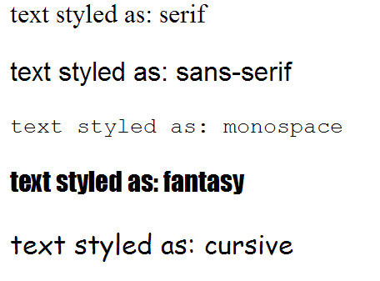
CSS properties and values
FONT-FAMILY

Slide 26
font-family (typeface) 5 generic browser fonts
There are 5 generic font families that ALL browsers must offer
similar whatever browser used (even if actual fonts vary)
serif: basic, business report / novel style font face
E.g. Times New Roman …
sans-serif: simple font (no serifs) – good for headings
E.g. Arial, Verdana …
monospace: a typewriter like font (every letter same width)
E.g. Courier
cursive: a hand-writing style font
E.g. Apple Chancery, Comic Sans
fantasy: Impact or other decorative fonts (to stand out)
different on every device – different to the other generics

Slide 27
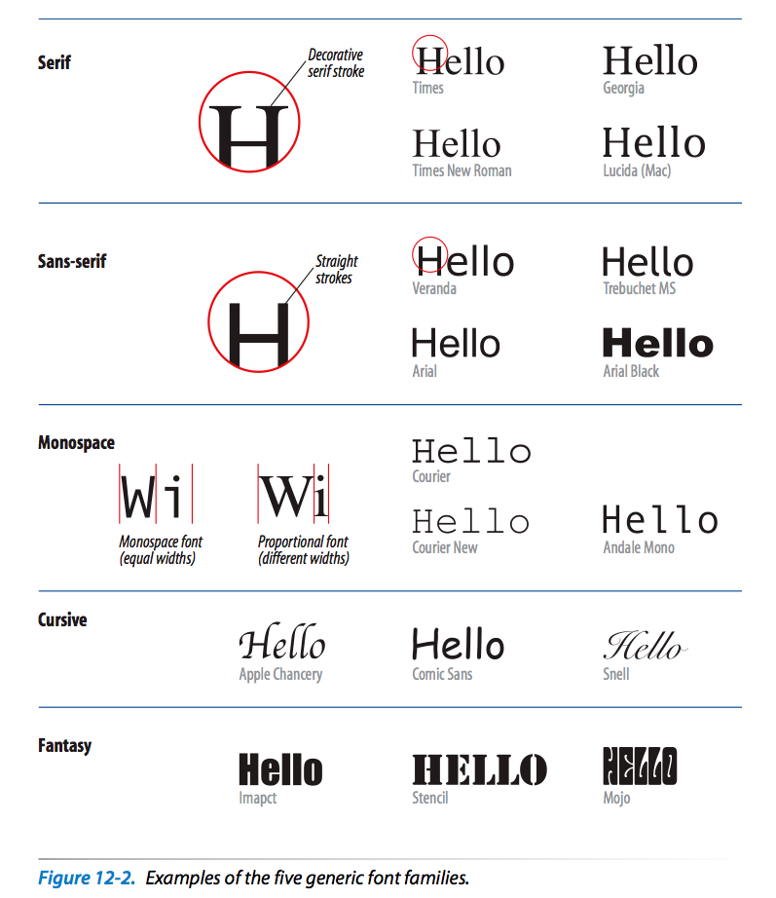

Slide 28
Property | Value(s)
font-family | serif /* like Times */
 | sans-serif /* like Arial */
 | monospace /* like Courier */
 | cursive /* handwriting style */
 | fantasy /* surprise me ! */
body { font-family: sans-serif; }
footer { font-family: monospace; }

Slide 29

/* ------ /css/goose.css ------ */
body {
background-color: lightblue;
/* make ALL page text typewriter */
font-family: monospace;
}
h1 {
color: red;
}
h2 {
font-variant: small-caps;
}
NOTE: Styles applied to selector ‘body’ apply to everything in the web page

Slide 30
5. TEST & VALIDATE as you go

Slide 31
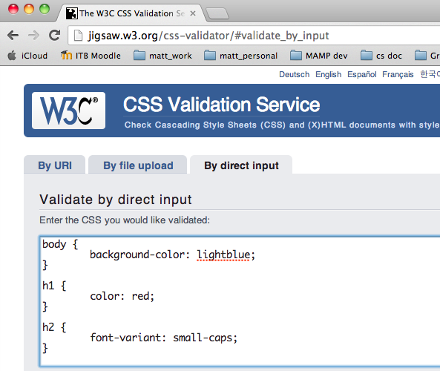

Slide 32
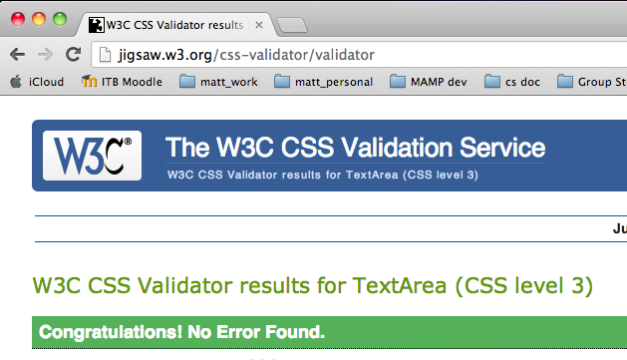

Slide 33
Summary and Conclusions

Slide 34
Summary / Conclusions …
Many text properties you can control
Font / size / color / bold / italics etc.
We’ll learn more in later lectures
We learnt how to change several text element properties
Practice / get used to @import and CSS style text file
Hav a bit of fun with colours and simple properties
Feel free to read ahead in the book / notes ...

